Slide 2
Purpose
Creates TOFU (Task Of Fictitious Unlearning)
This is a benchmark for testing
Tests whether an LLM can actually forget without damaging its remaining knowledge.
Evaluates existing methods by comparing with a baseline that never learned the forgotten information.

Slide 3
Problem
Addresses the challenge of selectively removing specific training information form an LLM while preserving its general utility and reliability verifying that the targeted knowledge has been forgotten.
How?
It compares the unlearned model with a retain-only model that was never trained on the targeted information.
A Kolmogorov-Smirnov (KS) test compares their truth ratio distributions on the forget set.

Slide 4
How is the problem solved?
It does not fully solve the problem.
It solves the evaluation problem using the benchmark to measure forgetting and retained utility. The paper tests a few unlearning methods but none successfuly remove the targeted knowledge without also reducing the performance.

Slide 5
Metrics
Probability – measures the models confidence in the correct answer
ROUGE-L – measures how closely the generated response matches the expected answer
Truth Ratio – Tests whether the model prefers the correc3t paraphrased answer over believable incorrect answers
Model Utility – Combines the above results across retained authors, real authors & world facts to check that general performance is preserved
KS Test p-value – Compares the unlearned model with a retain only model on the forgotten data. A high p value suggests the targeted knowledge is no longer statistically detectable.

Slide 6
Results
The model sucessfully learned TOFU
Llama-2-7B ROUGE-L increased from 0.3640 to 0.9849
Phi-1.5 increased from 0.4399 to 0.8693
Forgetting 1% was unsuccessful
Model utility remained stable but forget quality was too low
Phi p-values were below 0.001
Llama p-values never exceeded 0.01
Both remained under the 0.05 threshold
Continuing unlearning did not solve this
Increasing from 5 to 10 epochs was still unsuccessful for th 1%
Larger forget sets caused sever utility loss
5 % and 10% had some methods with better forget quality but worse usefulness
All methods demonstrated a privacy utility trade off
As forget quality improved , model utility decreased. Some models had meaningless responses after only 2 epochs
Notes:
Llama-2-7B = pretrained and fine tuned generative text model ranging in scale from 7B to 70B parameters

Slide 7
Results 2
Llama performed better than Phi overall
Llama maintained higher model utility but still failed to achieve reliable forgetting
Retain-set support was helpful
Methods using this generally performed better than those that only modeified forget set
Unlearning damaged related knowledge
Performance declined according to how closely the knopweldeg was related to forgotten info
Fake authors forgotten first -> real then real authors -> world facts most stable
Some methods behaved unpredictably
Gradient difference and preference optimization sometimes improved forget quality initialy then regained utility while becoming worse at forgetting
Multiple metrics were necessary
ROUGE-L, probility & Truth ratio had dsifference failure behaviours. A model could appear to forget based on the answer while still assigning high probability to the correct answer

Slide 8
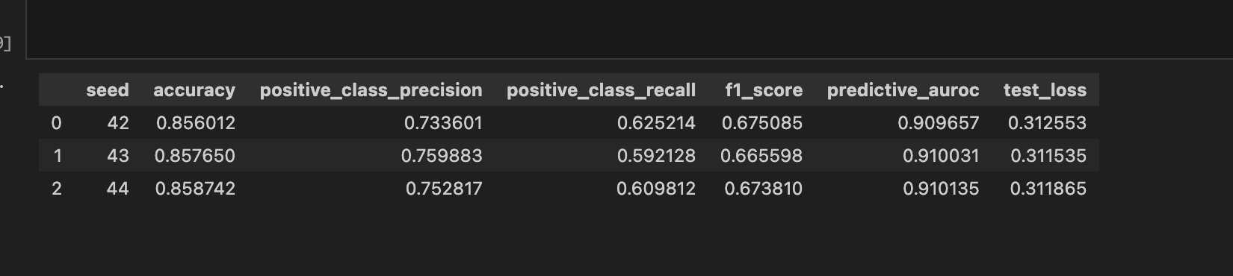
baseline

Slide 9
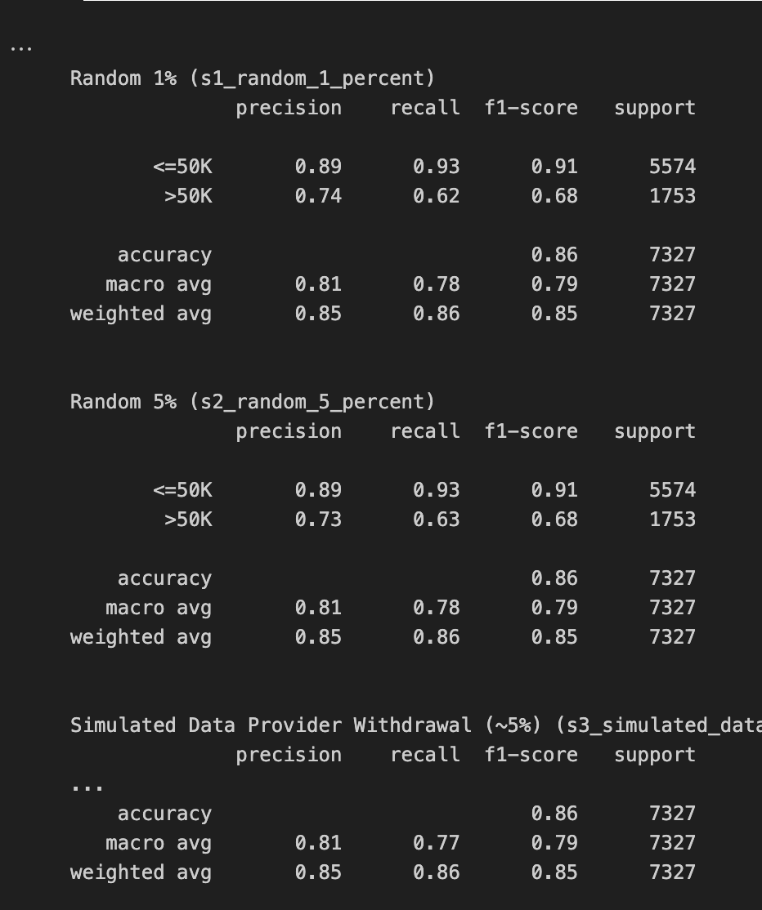
Removed forget

Slide 10
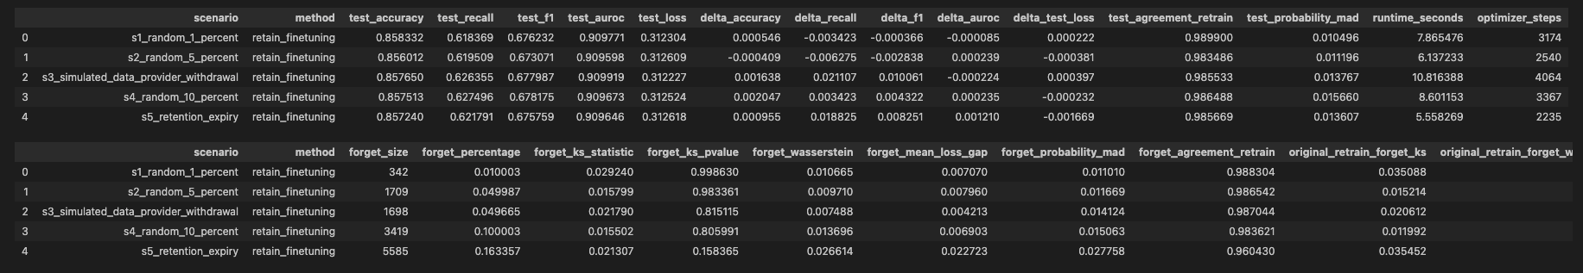
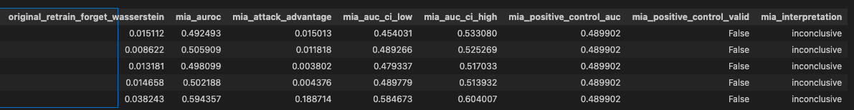


Retain set fine tuning
Top = utility table
Bottom = how close fine tuning is to full retraining
Notes:
Top :
Accuracy stays 85.60–85.83%.
F1 stays 0.673–0.678.
AUROC stays about 0.910.
Test agreement with full retraining is 98.35–98.99%.
Retain-set fine-tuning preserved general predictive utility and remained close to full retraining on the test set.
Bottom:
These are results specifically for the records meant to be forgotten.
Lower Wasserstein/probability distance is better; higher agreement is better.
Compare forget_wasserstein with original_retrain_forget_wasserstein: fine-tuning is closer to full retraining in 4 of 5 scenarios, but the evidence is mixed at individual-record level.
Do not include the MIA columns in this screenshot: they are inconclusive.
Fine-tuning provides some distribution-level movement toward the retrained model, but it does not consistently reproduce retraining for every forgotten record.
forget_Wasserstein = measures how different the fine tuned models predictions are from full retraining across the forget set
original_retrain_forget_Wasserstein = how far the untouched baseline was from full retraining
forget_agreement_retrain = proportion of forget recrods where both models make the same class decision . Higher is better

Slide 11
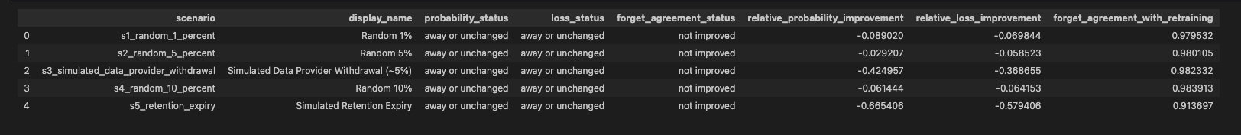
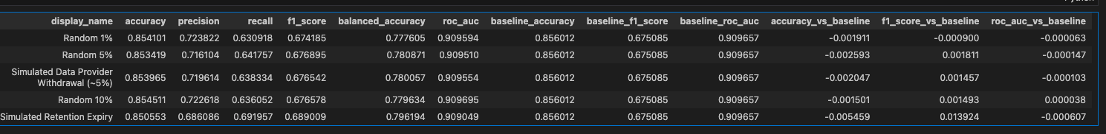
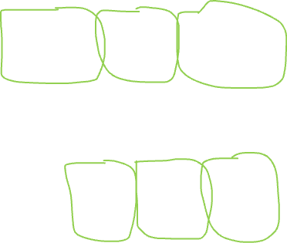
Gradient Ascent
Behaviour
forgetfulness
Notes:
Gradient-ascent forgetfulness table — use:
- relative_probability_improvement — most important. Positive means predictions moved closer to full retraining; every value is negative here. (+ve)
- relative_loss_improvement — confirms the same result using per-record model loss; again, negative is worse. (1)
forget_agreement_with_retraining — supporting measure only. It is high, but it ignores probability differences, so it can look good even when the main forgetting measures are negative.
Gradient-ascent utility table — use:
f1_score_vs_baseline — most important utility metric. It balances precision and recall, so it is better than accuracy alone for the imbalanced income classes. (0)
roc_auc_vs_baseline — confirms discrimination ability stayed unchanged across thresholds. (0)
accuracy_vs_baseline — simple supporting measure, but less important than F1. (0)
Utility: good. The changes in F1, accuracy, and AUROC are all very close to 0, so the model keeps roughly the same predictive performance as the baseline.
Forgetfulness: not good. Every relative_probability_improvement and relative_loss_improvement is negative, so gradient ascent moved the model further from the full-retraining reference on the records it was meant to forget.
Overall: gradient ascent changed the model without seriously harming its normal performance, but it did not produce convincing approximate unlearning in your experiment.

Slide 12
SISA
utility
forgetfulness

